Slide 1


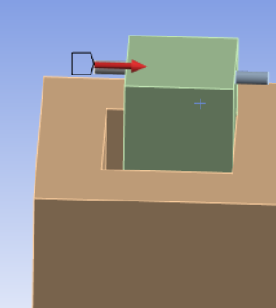
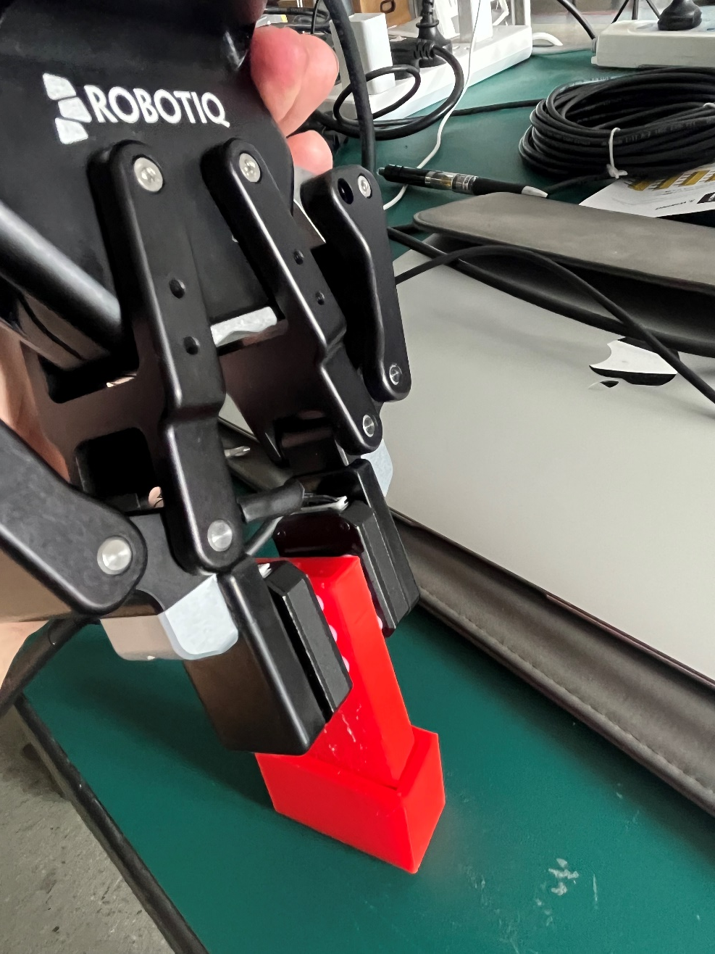
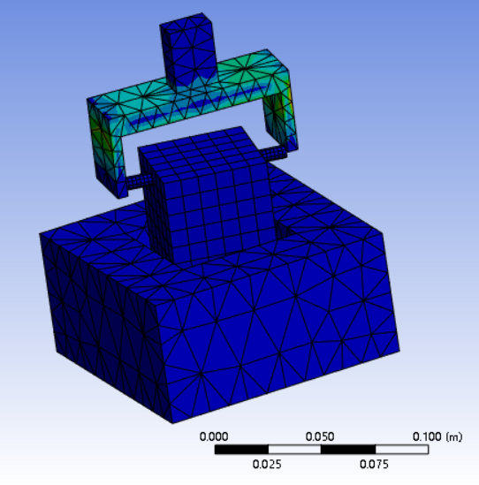
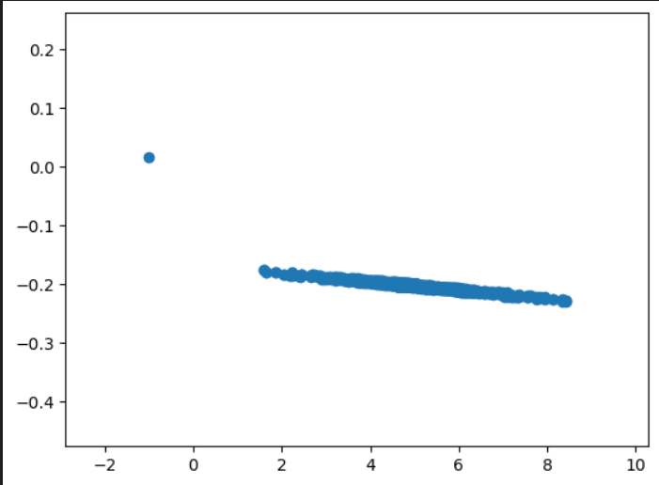
VG4903
Robotic arm motion control for contact-rich scenarios
Sponsor: UM-SJTU Joint Institute
Team Members: Juntao Wu
Instructor: Prof. Youyi Bi
Problem Statement
Industrial operations face persistent challenges in inserting components within contact-rich factory environments, resulting in inefficiencies, elevated costs, and safety concerns. Conventional rule-based methods struggle with the dynamic complexity of these tasks. This research investigates these challenges, focusing on contact-rich scenarios, aiming to identify limitations in rule-based approaches and explore alternative solutions to enhance operational efficiency. The goal is to contribute to advanced, adaptable solutions that optimize production processes, improve worker safety, and elevate overall manufacturing performance
Concept Generation
Integrate Finite Element Analysis (FEA) as a powerful tool to optimize force distribution within a sensor, ensuring accurate representation of physical forces in various scenarios. Leverage FEA not only for force modeling but also to enhance the robot's adaptability across diverse situations. Combine machine learning with FEA to create a smart sensor system enabling real-time decision-making in dynamic environments.
Fig. 1 FEA model
Design Description
The objective of this project is to design a robust and efficient peg-in-hole interaction system using Finite Element Analysis (FEA) modeling in ANSYS for simulation and validation, and integration with Unity for virtual environment visualization.
Fig.2 The whole set-up system
Modeling and Analysis
The integration of ANSYS for realistic modeling of the insertion process, coupled with the predictive capabilities of neural networks, offers a powerful approach for understanding, optimizing, and automating complex insertion scenarios in engineering applications. This combined methodology provides valuable insights that can be leveraged for improved efficiency and reliability in various industries.
Fig. 3 Data analysis
Validation
Validation Process:
Comparing data with real-world measurements involves a multifaceted approach that includes attention to accuracy, precision, reliability, traceability, statistical analysis, error analysis, cross-validation, field testing, documentation, and continuous improvement. Rigorous validation processes enhance confidence in the quality of data and contribute to informed decision-making in various domains.
Fig. 3 Real-time measurement
Conclusion
In conclusion, the research on robotic arm motion control for contact-rich scenarios represents a significant stride towards enhancing the adaptability and efficiency of robotic systems in real-world applications. The exploration of advanced control strategies and sensing technologies has allowed for a more nuanced and responsive interaction between robotic arms and their environments, particularly in scenarios .
Reference
[1] https://www.diva-portal.org/smash/get/diva2:1352852/FULLTEXT01

